Slide 1
Social Security & RR Retirement Tier 1 (Blue Form)
4491-14 Income - Social Security Benefits v11.0 VO.pptx
Form 1040 Line 20
Pub 4012 Tab 2
Pub 17 Chapter 11

Slide 2
Tax on Social Security benefits
Up to 85% of benefits can be taxable
May be taxable if one-half of social security plus all other income (including tax-exempt interest) is greater than:
$32,000 MFJ
$25,000 single, HOH or qualified widow
$25,000 MFS/lived apart all year
$0 MFS/lived together any part of year
TaxWise calculates taxable amount

Slide 3
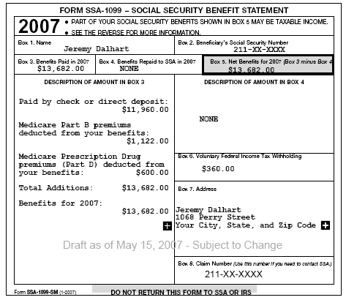

Slide 4
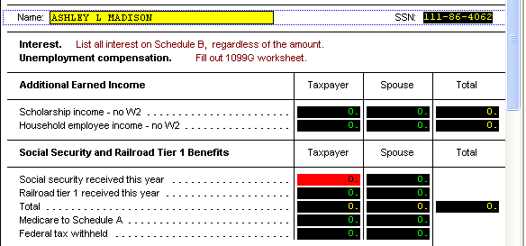
SS & RR Tier 1 Tax Wise 1040 Income Worksheet 1

Slide 5
Tax on RR Retirement Tier 1
Railroad Retirement Tier 1 – Blue Form (Pub 915)
RRB-1099
Same Rules as Social Security

Slide 6
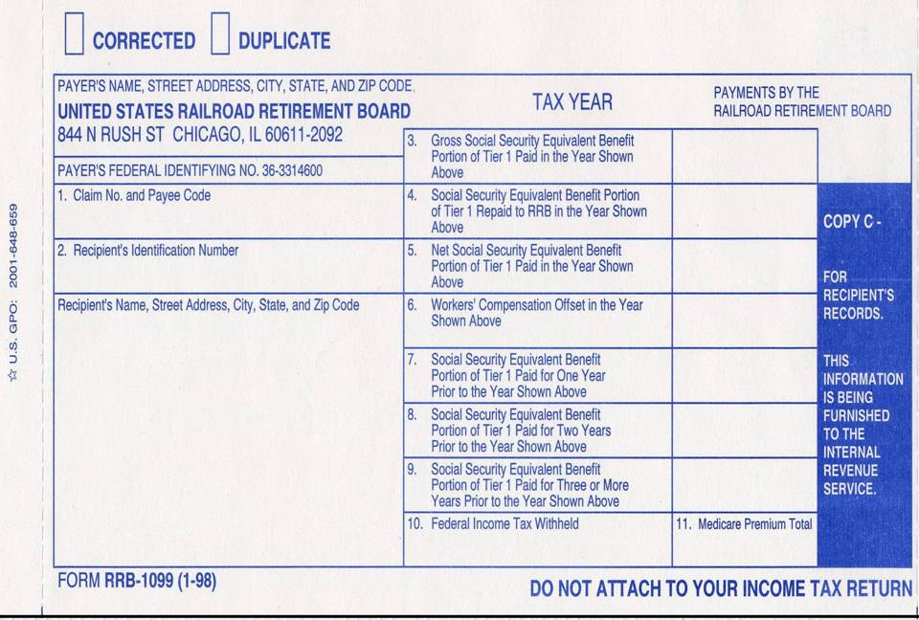
Social Security & Equivalent Railroad Retirement Benefits

Slide 7
FOREIGN OLD AGE PAYMENTS
Old age payments from Canada and Germany
By treaty are added to/treated as Social Security (Pub 115)
Taxpayer must have converted amount into US dollars (bank statement shows)
Not pensions

Slide 8
Lump Sum Social Security Payments For Prior Years
SSA-1099A, Box 3
To be handled only by counselors trained in Lump Sum Social Security Payments

